Slide 1
ART Adverse Effects
Dr TARAVAT FAKHERI

Slide 3
Maternal Adverse Effects

Slide 4
Cancer Risk

Slide 5
Counseling women about the risks of cancer from ovarian stimulation
Infertility itself may also be a risk factor for many gynecologic cancers.

Slide 6
Breast Cancer
The only association was between gonadotropins and breast cancer in women who remained nulliparous
Increased risk remaining only when ovulation induction was used for over 12 months
Age at the first IVF cycle might be a factor related with increased risk of breast cancer, with age over 30 years having an increased risk
or age over 40 years as shown in another study

Slide 7
Ovarian Cancer
The increase in ovarian cancer risk appears attributable to infertility itself than ovarian stimulation drugs

Slide 8
Endometrial Cancer
Endometrial cancer is associated with anovulation and with the unopposed effect of estrogens on the endometrium
Gonadotropins increased the risk for uterine cancer after a 10-year follow up.
Increased with the number of cycles of clomiphene citrate use

Slide 9
Polycystic ovary syndrome (PCOS), a condition associated with infertility, is linked to endometrial cancer.
It is difficult to separate the cancer risks attributable to infertility from that of fertility drugs

Slide 10
Nulliparity is a risk factor for breast, ovarian and endometrial cancers.
Women may be counseled that there is no clear evidence that short-term use of fertility drugs increases the risk of gynecologic cancers.
Short term may be defined as: ❜ less than 12 cycles for clomiphene, and
less than six cycles for gonadotropins

Slide 11
Pelvic infection after IVF
Reported to occur in 0.03–1% of cases. More common in patients with endometriomas or previous PID.
Can occur after oocyte retrieval or after embryo transfer on its own, as with cases of frozen embryo transfer or oocyte recipients.
Present days or weeks after the procedure.
Is associated with poor IVF outcome, and high rate of pregnancy loss.

Slide 12
Prophylaxis
Strict aseptic precautions before the procedure.
Antiseptics for vaginal preparation before oocyte retrieval have not been shown to reduce the incidence of infection as compared with normal saline.
Prophylactic antibiotics at oocyte retrieval or embryo transfer have not been shown to reduce the incidence of infection, but it is prudent to use them in cases at high risk, such as women with endometrioma and previous PID.

Slide 13
Adnexal torsion after IVF
Adnexal torsion accounts for 3% of gynecologic surgical emergencies. Women of reproductive age are at greatest risk for adnexal torsion.
The right adnexa is more commonly affected.
After IVF, the incidence of torsion is 0.1%,
Risk increases if IVF is complicated by OHSS.
OHSS with concomitant pregnancy further increases the risk of adnexal torsion.
Although ultrasonography is a useful tool to evaluate for adnexal torsion, clinical suspicion is paramount.

Slide 14
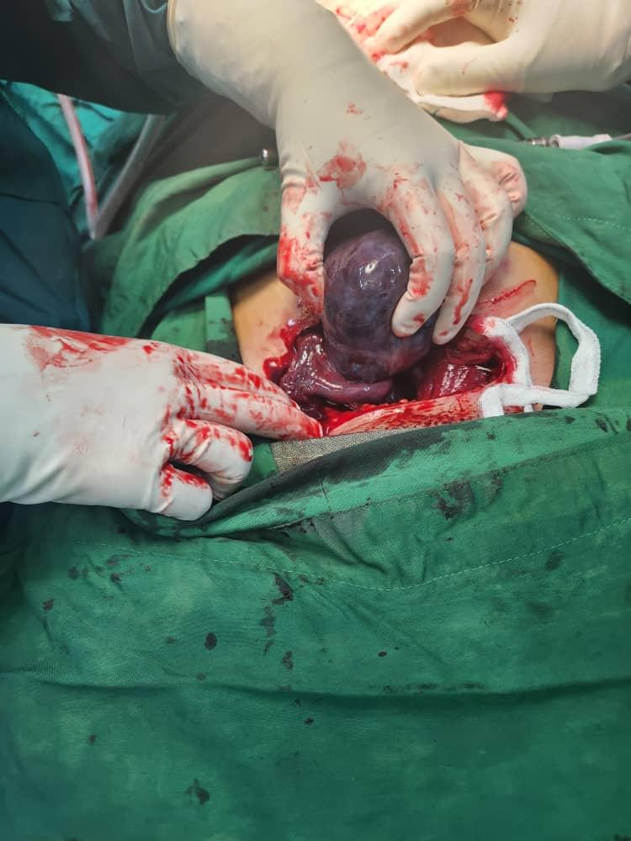

Slide 15
Management
Prompt surgical management is essential for ovarian preservation and to prevent more serious sequelae.
Laparoscopy is the preferred surgical approach. In reproductive age women, detorsion is preferred over oophorectomy in order to preserve ovarian function.

Slide 16
Prevention
Recognize women who are at high risk of ovarian torsion.
Minimize the risk of OHSS during ovarian stimulation.
With torsion recurrence, surgical management may involve utero-ovarian plication, ovariopexy or oophoropexy.

Slide 17
Risk of early menopause following IVF treatment
The question is frequently raised by women undergoing IVF treatment. Women with fertility problems have a higher background risk of reaching menopause earlier than fertile women. Gonadotropin stimulation does not cause depletion of primordial follicles. Women with a compromised ovarian reserve (indicating ovarian aging) are at risk of becoming menopausal earlier than women with a good ovarian reserve.
Reassure women that the procedures involved in the IVF treatment cycle do not put them at a risk of reaching earlier menopause. There is no association between the number of attempts at IVF treatment and the age at menopause.

Slide 18
Endometrial polyp detected during ART treatment
For polyps identified during COS, the decision on polypectomy will need to be individualized based on polyp size, previous reproductive history and the clinic’s success rates for the frozen embryo program:

Slide 19
If the polyp is small (1.5 cm) or if there is a history of implantation failure or recurrent miscarriage, then the option of freezing all embryos, polypectomy, followed by FET 2– 3 months later should be considered.
Polypoid endometrium does not require treatment from the fertility point of view, although a biopsy may be needed to rule out hyperplasia or cancer in older women and women with menstrual disorders.
Polypectomy is best performed under direct hysteroscopic visualization or, if the polyp has a broad base, with a resectoscope.

Slide 20
. The ultrasound should ideally be performed in follicular phase, preferably soon after the menstrual bleeding stops. If a polyp is suspected, then hysteroscopic examination (with polypectomy if appropriate) should be arranged.
Some centers employ routine saline sonography, three-dimensional ultrasound scan or hysteroscopy before IVF treatment to rule out a polyp and other uterine anomalies.

Slide 22
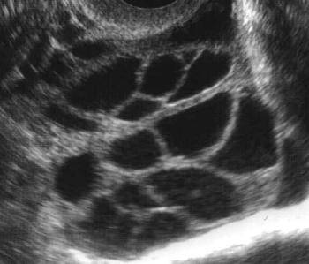
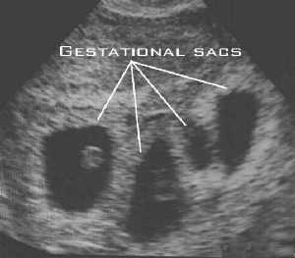
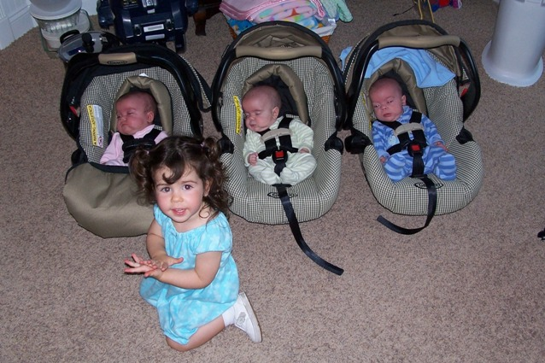

Slide 23
OHSS (OVARIAN HYPER STIMULATION SYNDROME)
Acute fluid shift out of the intravascular space
Ascites
Hydrothorax
Generalized edema
Major electrolyte imbalance
Reduced renal perfusion
Marked hemoconcentration
Vascular complications

Slide 24
Risk factors of OHSS
Young age
Low body weight
PCOS (50% OHSS – 6% Severe OHSS)
High dose of gonadotropins
Previous hyper stimulation
Increase of serum estradiol
Increase of number of developing ovarian follicles

Slide 25
Ovarian stimulation drugs:
HMG: OHSS is reported in up to 23% of cases (FSH+LH).
Pure FSH: OHSS is reported to be lower in these cases.
Clomid: mild degree occur in 13.5%. the incidence is increased when combined with hMG.

Slide 26
Recent classification of OHSS (Jenkins&Mathur,1998)
1)Mild.
2)Moderate.
3)Severe.
4)Critical.

Slide 27
Mild OHSS
One third of Super Ovulation Cycle
Ovarian Enlargement
Lower Abdominal Discomfort
Mild Nausea and Vomiting
Diarrhea
Abdominal Distension

Slide 28
Serious OHSS
Severe 1%
Severe pain
Rapid weight gain
Tens ascites
Hemodynamic instability
Respiratory difficultly
Progressive oliguria
Laboratory abnormalities
Hypotension

Slide 29
Life-threatening Complication of OHSS
Renal failure
ARDS
Ovarian rupture
Thromboemboly

Slide 30
Complications of OHSS:
Miscarriage 30-50%
Congenital malformation: Increased incidence due to abnormal steroid levels & drugs
Ovarian cancer: The relation was suggested by some authors but with no general acceptance

Slide 31
EARLY OHSS
Onset < 9days of oocyte retrieval
High S. estradiol
High follicle numbers
Possibly due to exogenous hCG to trigger ovulation
LATE OHSS
onset > 9days of oocyte retrieval
Association with multiple gestation
Possibly due to endogenous hCG when pregnancy ensues

Slide 32
ART Fetal complications
Approximately 16% of pregnancies result in miscarriage,
induced abortion (1.0%),
stillbirth (0.7%),
or an ectopic pregnancy (0.5%).

Slide 33
11% of cycles are discontinued before retrieval, due to an inadequate (82.3%) or excessive response (4.2%) to stimulation, a concurrent medical illness (0.9%), or a patient’s own personal reasons (12.5%)
success rates were higher for women with a previous live birth and those in their first ART cycle than for NG & HX of failed ART.

Slide 34
Multiple Gestation
multiple deliveries has significantly declined since 1998 due to a trend toward reduction in embryo transfer order, twin rates remain high.
In 2015, 22.7% and 16.8% of all births in the United States resulting from fresh and FETs, respectively, were multiples, a rate 5–7 times higher than the 3% multiple-infant birth rate in the general population;
22.1% of live births after fresh nondonor embryo transfers were twins and 0.6% were triplets or more.

Slide 35
Success rates increase with the number of embryos transferred, to a point,beyond which only the multiple pregnancy rate further increases.
Female age
number of embryos generated
number of embryos transferred

Slide 36
Younger women tend to have both higher success rates and higher multiple-infant birth rates

Slide 37
Offspring of IVF
increased risk for prematurity,
low birth weight,
birth defects,
genetic and epigenetic abnormalities,
vascular and metabolic abnormalities,
delayed neurologic development,
and cancer.

Slide 38
ART singleton pregnancies
higher risk of antepartum hemorrhage
hypertensive disorders of pregnancy
gestational diabetes
preterm rupture of membranes
caesarean section
induction of labor

Slide 39
Stillbirth between 22nd and 28th gestational weeks is increased by
twofolds for ART singletons compared to those spontaneously conceived.
stillbirth is similar after the 28th GA
The ART twins have a lower risk of stillbirth compared to spontaneously conceived twins;
DZ twins , the risk seems similar in the two groups.
The risk of early neonatal and infant deaths for ART singletons and twins seems similar with spontaneously conceived singletons and twins.

Slide 40
Large-for-Gestational Age Babies
Singletons conceived after FET have an increased risk of being LGA, and having macrosomia,
defined as a birth weight greater than 4,500 g.

Slide 41
Congenital Anomalies
Several meta-analyses revealed a 30–40% increase in relative risk of birth defects in singleton and multiple ART pregnancies , compared to spontaneous conceptions .

Slide 42
Tracheoesophageal fistula/
esophageal atresia
rectal and large intestinal atresia/stenosis
and reduction deformity of the lower limbs

Slide 43
Mothers in the assisted conception group were
older and
were more likely to be nulliparous,
white,and
higher socioeconomic status.

Slide 44
Chromosomal, Genetic, and Epigenetic Abnormalities
the prevalence of chromosomal abnormalities in children
conceived with ART is not different from that in children conceived naturally.
Nonetheless, concerns persist that the use of sperm from infertile men, and ICSI itself,
might increase the risk for conceiving a child with a chromosomal or genetic defect, because infertile men (and women) are more likely than fertile men (and women) to have a genetic abnormality that may contribute to their infertility

Slide 45
children may inherit
Beckwith-Wiedemann syndrome (Macroglossia,hemihyperplasia,omphalocele,macrosomia embryonal tumors,…)
Angelman syndrome,(CNS ,physical & learning disability)
maternal hypomethylation syndrome.
The relative risks of these syndromes were the same in subfertile women with or without ART.
subfertility rather than ART procedures is responsible.

